Slide 1

CytoAutoCluster: A Semi-Supervised Deep Approach for Cytometry Data Analysis
CytoAutoCluster is a novel semi-supervised deep learning approach that tackles the challenges of analyzing high-dimensional cytometry data.
AS
by ABHAY RAJ SINGH

Slide 2

Introduction and Objectives
1
Cytometry Data Analysis
2
High-Dimensional Data
Cytometry data provides insights into cellular populations, playing a crucial role in immunology, oncology, and biomarker discovery.
High-dimensional cytometry data, like that generated by CyTOF, presents challenges for traditional clustering algorithms, often leading to inaccurate results.
3
Objective: Preprocessing and Analysis
4
Objective: Semi-Supervised Clustering
CytoAutoCluster aims to effectively preprocess and analyze this complex data to achieve meaningful insights.
By utilizing a semi-supervised approach, the model leverages both labeled and unlabeled data to improve clustering performance and interpretability.

Slide 3
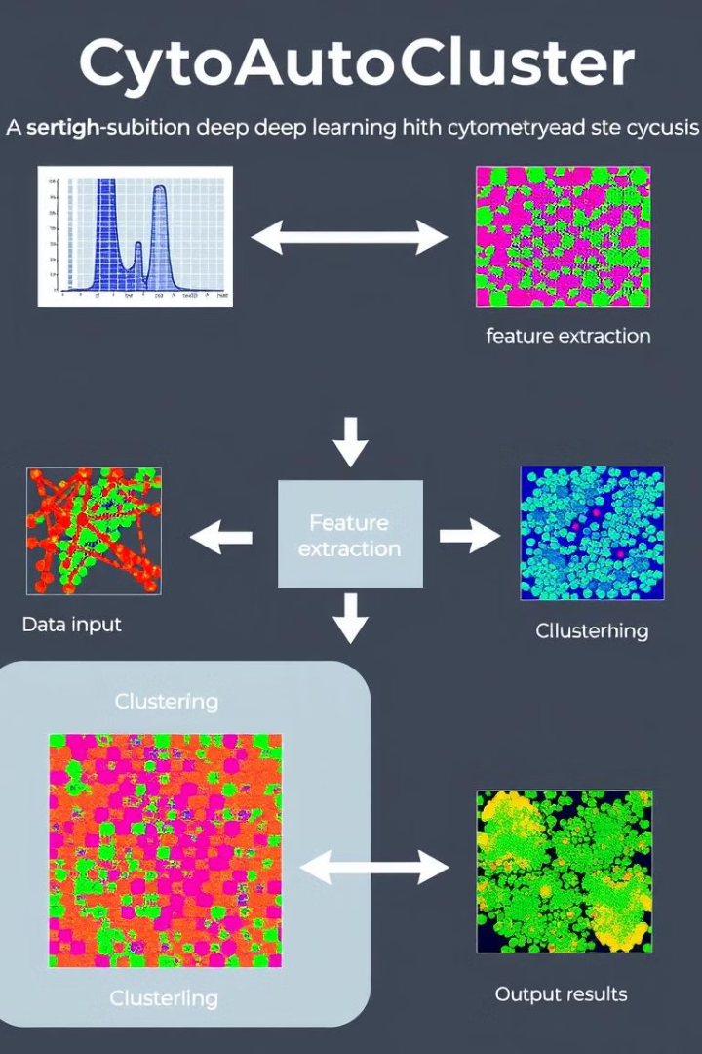
Dataset Overview
Characteristic
Details
Cells (n)
265,627
Markers (p)
32
Manually Labeled Cells
39% (104,184 cells)
Clusters (k)
14
Unlabeled Cells
61%(161,443 cells)
Source
Cytobank Platform

Slide 4

Challenges and Motivation
High Dimensionality
Label Imbalance
Noise and Inconsistency
The vast number of features (markers) in cytometry data makes it difficult to visualize and analyze effectively.
The limited availability of labeled data in many cytometry datasets poses a challenge for supervised learning methods.
Noise from instrumentation and sample preparation can further complicate the analysis, leading to inaccurate results.

Slide 5

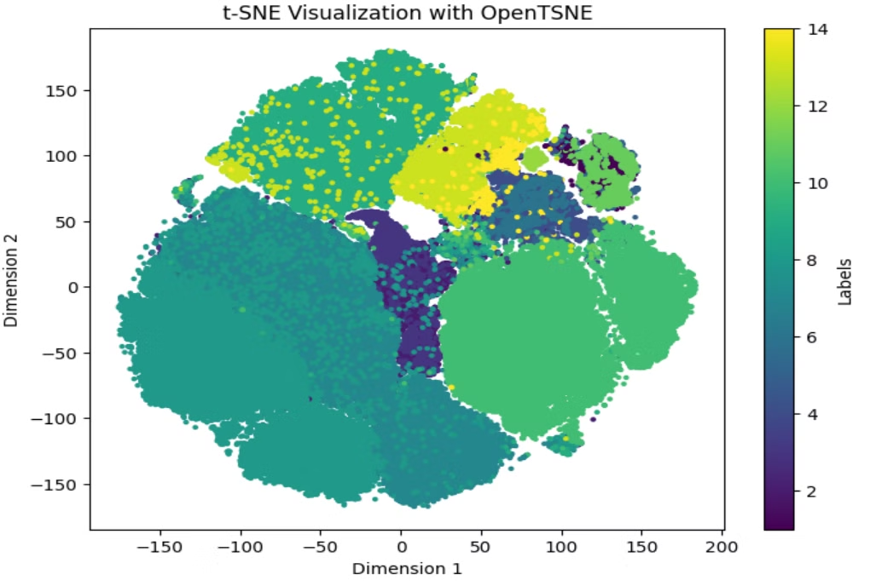
Methodology
1
Data Preprocessing
Normalization and exploratory analysis are performed to prepare the data for clustering.
2
Dimensionality Reduction
PCA and t-SNE are utilized to reduce the dimensionality of the data while preserving important relationships.
3
Clustering Techniques
An autoencoder-based approach is employed for feature learning and semi-supervised clustering to leverage labeled and unlabeled data.
4
Model Training
The model is trained and fine-tuned using logistic regression and XGBoost for improved performance.

Slide 6

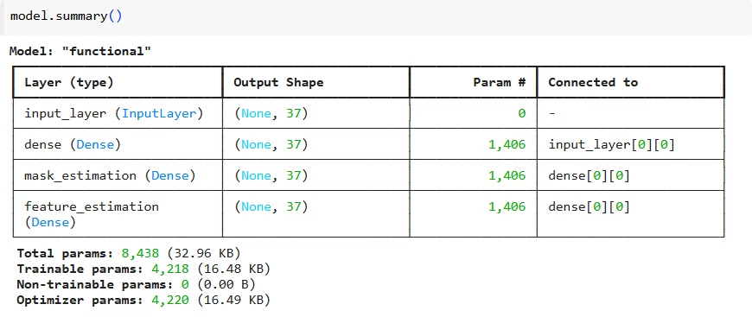
Model Architecture and Implementation
Self-Supervised Encoder
Training Details
The encoder takes 32-dimensional input, uses fully connected layers with ReLU activation, and outputs mask estimation and feature reconstruction.
The model is trained using a batch size of 128, for 50 epochs, with loss functions including binary cross-entropy and mean squared error (MSE).

Slide 7


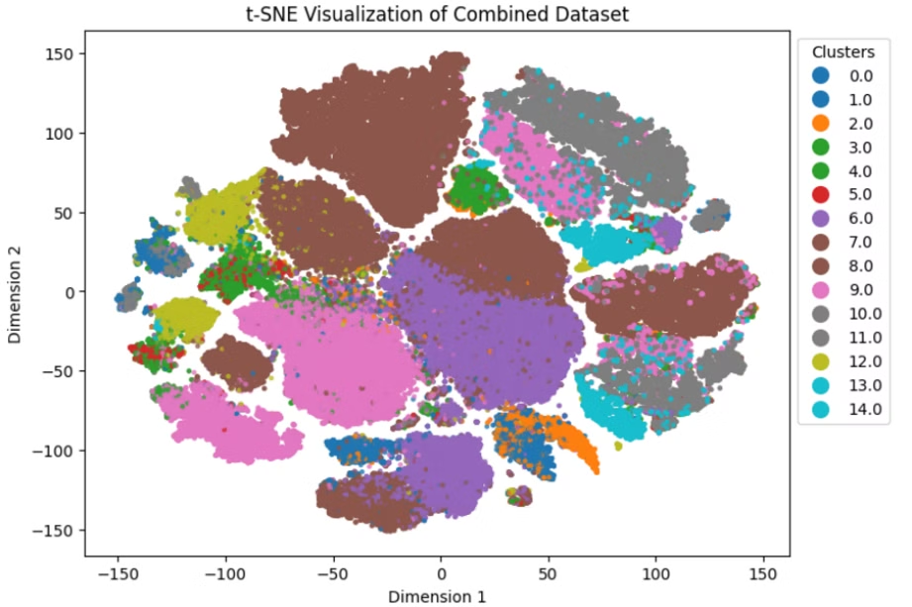


Results and Evaluation
Accuracy
The model achieved a 89.9% accuracy in self-supervised clustering, indicating its ability to identify cell types.
AUROC
The area under the receiver operating characteristic curve (AUROC) reached 99.09%, demonstrating strong predictive power.
Log Loss
Log loss for logistic regression and XGBoost were 0.0299 and 0.0039, respectively, suggesting good calibration.

Slide 8


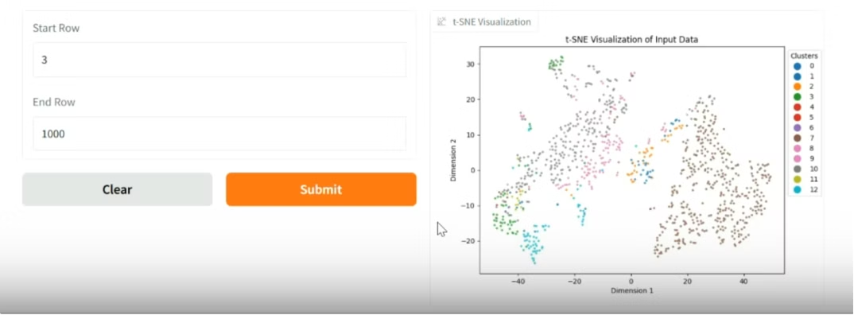



Gradio Interface for User Interaction
Purpose
Provides an interactive visualization and prediction tool for users.
Key Functions
Processes unlabeled data, predicts cell types, and dynamically visualizes clusters using t-SNE.
Implementation Demo Link

Slide 9

Challenges and Solutions
1
Noisy Data
2
Label Imbalance
Data preprocessing techniques like filtering and outlier removal are employed to mitigate the impact of noise.
Semi-supervised learning approaches, like those implemented in CytoAutoCluster, help to address label imbalance by leveraging both labeled and unlabeled data.
3
High Dimensionality
Dimensionality reduction techniques like PCA and t-SNE are crucial to manage high-dimensional data effectively.

Slide 10
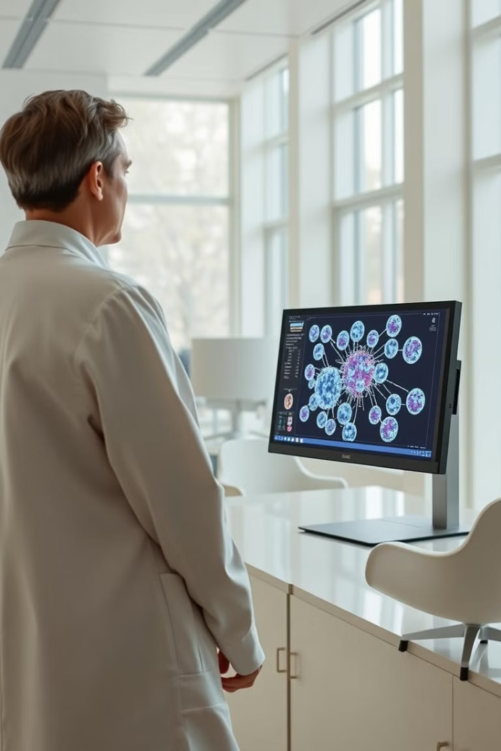
Conclusion and Future Work
Conclusion
Future Work
CytoAutoCluster demonstrates the effectiveness of semi-supervised deep learning in analyzing high-dimensional cytometry data.
Future research will focus on expanding the model to multi-omics datasets, scaling the model to analyze millions of cells, and addressing cross-laboratory variability with domain adaptation.

